Slide 1



Android Support for Programming Concurrent & Networked Software: Part 1
Douglas C. Schmidt
d.schmidt@vanderbilt.edu
www.dre.vanderbilt.edu/~schmidt
Professor of Computer Science
Institute for Software Integrated Systems Vanderbilt University Nashville, Tennessee, USA

Slide 2
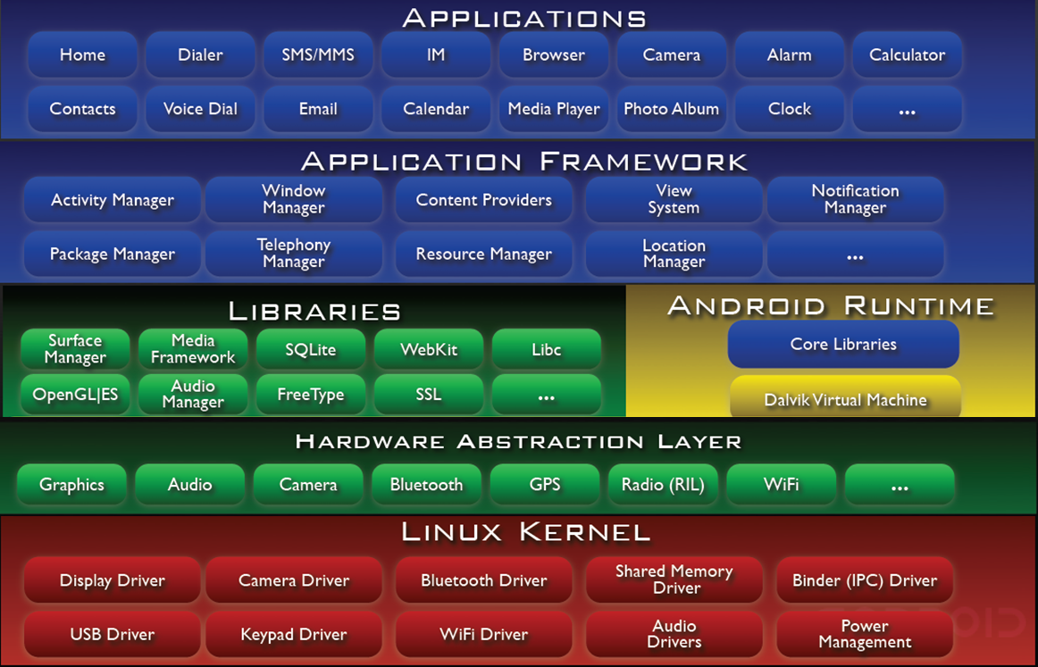
Topics Covered in this Part of the Module
Present an overview of the Android software architecture

Slide 3
What is Android?
Android provides a layered software stack for mobile devices, including
A variant of the Linux OS optimized for power conservation & local IPC
Java/JNI
C++/C
C

Slide 4
What is Android?
Android provides a layered software stack for mobile devices, including
A variant of the Linux OS optimized for power conservation & local IPC
An optimized Java Virtual Machine (Dalvik), a subset of Java libraries running on Dalvik, native C/C++ libraries, & a hardware abstraction layer
C++/C
C

Slide 5
What is Android?
Android provides a layered software stack for mobile devices, including
A variant of the Linux OS optimized for power conservation & local IPC
An optimized Java Virtual Machine (Dalvik), a subset of Java libraries running on Dalvik, native C/C++ libraries, & a hardware abstraction layer
Middleware, including
GUIs
Telephony services
Camera
Multimedia
App frameworks
App Distribution
etc.
Java/JNI
C++/C
C

Slide 6
What is Android?
Android provides a layered software stack for mobile devices, including
A variant of the Linux OS optimized for power conservation & local IPC
An optimized Java Virtual Machine (Dalvik), a subset of Java libraries running on Dalvik, native C/C++ libraries, & a hardware abstraction layer
Middleware, including
GUIs
Telephony services
Camera
Multimedia
App frameworks
App Distribution
etc.
Common set of apps
Java/JNI
C++/C
C
See developer.android.com/guide/basics/what-is-android.html for more

Slide 7

Linux Kernel
C
Provides infrastructure mechanisms to manage mobile device resources
Memory, process, & thread management
Network & inter-process communication stack
Device driver framework
Security

Slide 8
Linux Kernel
C
Provides infrastructure mechanisms to manage mobile device resources
Memory, process, & thread management
Network & inter-process communication stack
Device driver framework
Security
Android-specific enhancements
Binder – optimized inter-process communication (IPC)
Android shared memory
Power management
Alarm driver
Low memory killer
Kernel debugger & Logger
en.wikipedia.org/wiki/Android_(operating_system)#Linux has more info

Slide 9
Hardware Abstraction Layer (HAL)
C++/C
User space C/C++ library layer that defines the interface Android requires hardware “drivers” to implement
The HAL helps to decouple
Android platform logic from hardware interface
Android frameworks from Linux kernel

Slide 10
Hardware Abstraction Layer (HAL)
C++/C
User space C/C++ library layer that defines the interface Android requires hardware “drivers” to implement
The HAL helps to decouple
Android platform logic from hardware interface
Android frameworks from Linux kernel
Motivation for a user-space HAL
Not all components have standardized kernel driver interfaces
Android has specific requirements for hardware drivers
Kernel drivers are GPL, which exposes proprietary intellectual property of Android
Implementations of HAL components are often not open-source
See tidsp.es.ncku.edu.tw/cinfon/resource/slides/11102012_02_final.pdf

Slide 11

Native C/C++ Libraries
C++/C
System C library
bionic libc
Surface Manager
display management
Media Framework
audio/video streaming
FreeType
library for rendering fonts
Webkit
web browser engine
OpenGL ES, SGL
graphics engines
SQLite
relational database engine
SSL
secure sockets layer

Slide 12
Native C/C++ Libraries
C++/C
System C library
bionic libc
Surface Manager
display management
Media Framework
audio/video streaming
FreeType
library for rendering fonts
Webkit
web browser engine
OpenGL ES, SGL
graphics engines
SQLite
relational database engine
SSL
secure sockets layer
developer.android.com/tools/sdk/ndk/index.html has info on Android NDK

Slide 13


Android Runtime
C/Java/JNI
Support services for executing apps & frameworks
Dalvik Virtual Machine (VM)
Android apps typically written in Java, but don’t run in a standard Java VM
Notes:
http://www.flickr.com/photos/13742462@N00/8186466394/

Slide 14
Android Runtime
C/Java/JNI
Support services for executing apps & frameworks
Dalvik Virtual Machine (VM)
Android apps typically written in Java, but don’t run in a standard Java VM
Bytecodes executed in Dalvik VM “register machine”
dx program transforms java classes into .dex-formatted bytecodes
Just-in-time (JIT) compiler available

Slide 15
Android Runtime
C/Java/JNI
Support services for executing apps & frameworks
Dalvik Virtual Machine (VM)
Android apps typically written in Java, but don’t run in a standard Java VM
Bytecodes executed in Dalvik VM “register machine”
dx program transforms java classes into .dex-formatted bytecodes
Just-in-time (JIT) compiler now available
Apps typically run in their own processes, inside their own Dalvik VM instance
Browser App
Browser Activities
Core Libs
Dalvik VM
libC
See en.wikipedia.org/wiki/Dalvik_(software) for more on Dalvik

Slide 16
Android Runtime
C/Java/JNI
Support services for executing apps & frameworks
Dalvik Virtual Machine (VM)
Android apps typically written in Java, but don’t run in a standard Java VM
Bytecodes executed in Dalvik VM “register machine”
dx program transforms java classes into .dex-formatted bytecodes
Just-in-time (JIT) compiler now available
Apps typically run in their own processes, inside their own Dalvik VM instance
Core Libraries
Core Java classes
android.*
java.*, javax.*
junit.*
org.apache.*, org.json.*, org.xml.*

Slide 17
Android Runtime
C/Java/JNI
Support services for executing apps & frameworks
Dalvik Virtual Machine (VM)
Android apps typically written in Java, but don’t run in a standard Java VM
Bytecodes executed in Dalvik VM “register machine”
dx program transforms java classes into .dex-formatted bytecodes
Just-in-time (JIT) compiler now available
Apps typically run in their own processes, inside their own Dalvik VM instance
Core Libraries
Core Java classes
android.*
java.*, javax.*
junit.*
org.apache.*, org.json.*, org.xml.*
Doesn’t include all standard Java SDK classes
en.wikipedia.org/wiki/Comparison_of_Java_and_Android_API has more info

Slide 18
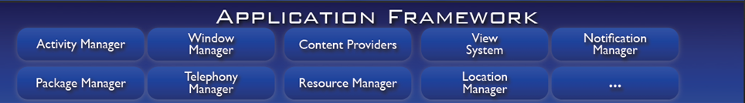
Application Frameworks
Java/JNI
Provide services that are essential to the Android platform
Window Manager
Manages top-level window’s look & behavior
View System
Lists, grids, text boxes, buttons, etc.
Content Providers
Inter-application data sharing
Activity Manager
Application lifecycle & common navigation stack
Package Manager
Manages application packages
Telephony Manager
State of telephony services
Resource Manager
Manages non-code resources: strings, graphics, & layout files
Location Manager
Access to system location services
Notification Manager
Notify users when events occur

Slide 19
Application Frameworks
Java/JNI
Provide services that are essential to the Android platform
Window Manager
Manages top-level window’s look & behavior
View System
Lists, grids, text boxes, buttons, etc.
Content Providers
Inter-application data sharing
Activity Manager
Application lifecycle & common navigation stack
Package Manager
Manages application packages
Telephony Manager
State of telephony services
Resource Manager
Manages non-code resources: strings, graphics, & layout files
Location Manager
Access to system location services
Notification Manager
Notify users when events occur
sites.google.com/site/io/inside-the-android-application-framework has more info

Slide 20
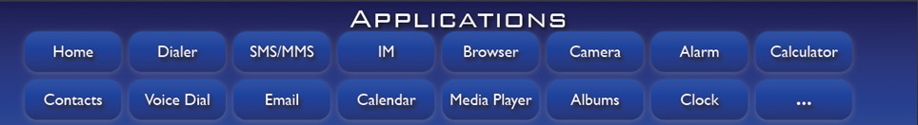
Applications
Java/JNI
Some standard apps include:
Home
main screen
Contacts
contacts database
Calendar
track schedules
Camera
take photos & videos
Phone
dial phone numbers
Browser
view web pages
Email reader
Gmail & others
Media player
Play songs & watch movies
SMS/MMS
Instant messaging
All apps written using Java (Android frameworks use many JNI calls to C/C++)

Slide 21
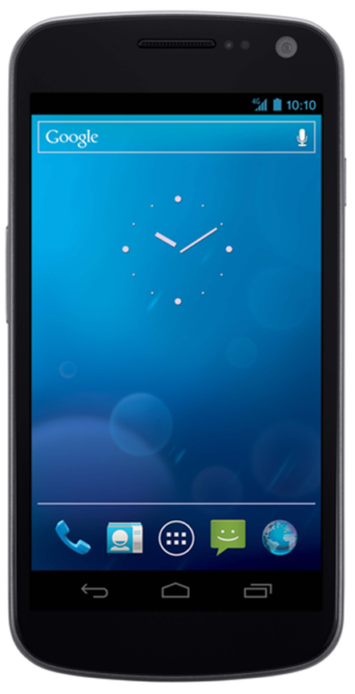

Key Types of Android Components
Activity
Represents a single screen with a user interface
1: Activity calls downloadImage() with image URL
See www.dre.vanderbilt.edu/~schmidt/cs282 for info on this app

Slide 22
Key Types of Android Components
Activity
Represents a single screen with a user interface
Can be started by creating an Intent object & passing it to startActivity()
Parameters can be passed as “extras” to the Intent used to start the Service
1: Activity calls downloadImage() with image URL

Slide 23
Key Types of Android Components
Activity
Represents a single screen with a user interface
Can be started by creating an Intent object & passing it to startActivity()
Parameters can be passed as “extras” to the Intent used to start the Service
Apps can have multiple Activities
1: Activity calls downloadImage() with image URL
See developer.android.com/guide/components/activities.html for more info

Slide 24
Key Types of Android Components
Activity
Represents a single screen with a user interface
Service
Runs in background to perform long-running operations or to access remote resources
1: Activity calls downloadImage() with image URL
Download Service
2: Sends GET request to web server

Slide 25
Key Types of Android Components
Activity
Represents a single screen with a user interface
Service
Runs in background to perform long-running operations or to access remote resources
Started Service – Often performs a single operation & usually doesn’t return a result to the caller directly
Parameters can be passed as “extras” to the Intent used to start the Service
Download Service
1: Activity calls downloadImage() with image URL
2: Sends GET request to web server

Slide 26
Key Types of Android Components
Activity
Represents a single screen with a user interface
Service
Runs in background to perform long-running operations or to access remote resources
Started Service – Often performs a single operation & usually doesn’t return a result to the caller directly
Parameters can be passed as “extras” to the Intent used to start the Service
Bound Service – Offers a client-server interface that allows components to interact with the Service
e.g., via the Android Interface Definition Language (AIDL) & Binder RPC
Download Service
1: Activity calls downloadImage() with image URL
2: Sends GET request to web server
See developer.android.com/guide/components/services.html for more info

Slide 27
Key Types of Android Components
Activity
Represents a single screen with a user interface
Service
Runs in background to perform long-running operations or to access remote resources
Content Provider
Manages a shared set of application data
1: Activity calls downloadImage() with image URL
Download Service
2: Sends GET request to web server
3: Stores downloaded image in filesystem & metadata in Content Provider
Image Metadata Content Provider
Image Files

Slide 28
Key Types of Android Components
Activity
Represents a single screen with a user interface
Service
Runs in background to perform long-running operations or to access remote resources
Content Provider
Manages a shared set of application data
Data typically stored persistently in an SQLite database
1: Activity calls downloadImage() with image URL
Download Service
2: Sends GET request to web server
3: Stores downloaded image in filesystem & metadata in Content Provider
Image Metadata Content Provider
Image Files

Slide 29
Key Types of Android Components
Activity
Represents a single screen with a user interface
Service
Runs in background to perform long-running operations or to access remote resources
Content Provider
Manages a shared set of application data
Data typically stored persistently in an SQLite database
Never accessed directly, but via a Content Resolver
1: Activity calls downloadImage() with image URL
Download Service
2: Sends GET request to web server
3: Stores downloaded image in filesystem & metadata in Content Provider
Image Metadata Content Provider
Image Files
developer.android.com/guide/topics/providers/content-providers.html has more

Slide 30
Key Types of Android Components
Activity
Represents a single screen with a user interface
Service
Runs in background to perform long-running operations or to access remote resources
Content Provider
Manages a shared set of application data
Broadcast Receiver
A component that responds to system-wide Intent broadcast announcements
5: Activity receives intent & displays image
Download Service
2: Sends GET request to web server
3: Stores downloaded image in filesystem & metadata in Content Provider
4. Broadcasts intent containing image URI
Image Metadata Content Provider
Image Files

Slide 31
Key Types of Android Components
Activity
Represents a single screen with a user interface
Service
Runs in background to perform long-running operations or to access remote resources
Content Provider
Manages a shared set of application data
Broadcast Receiver
A component that responds to system-wide Intent broadcast announcements
Supports complex Intent filtering
5: Activity receives intent & displays image
Download Service
2: Sends GET request to web server
3: Stores downloaded image in filesystem & metadata in Content Provider
4. Broadcasts intent containing image URI
Image Metadata Content Provider
Image Files
See developer.android.com/reference/android/content/BroadcastReceiver.html

Slide 32
Summary
Android defines a layered software stack for mobile device
sites.google.com/site/io/anatomy--physiology-of-an-android has Android overview

Slide 33
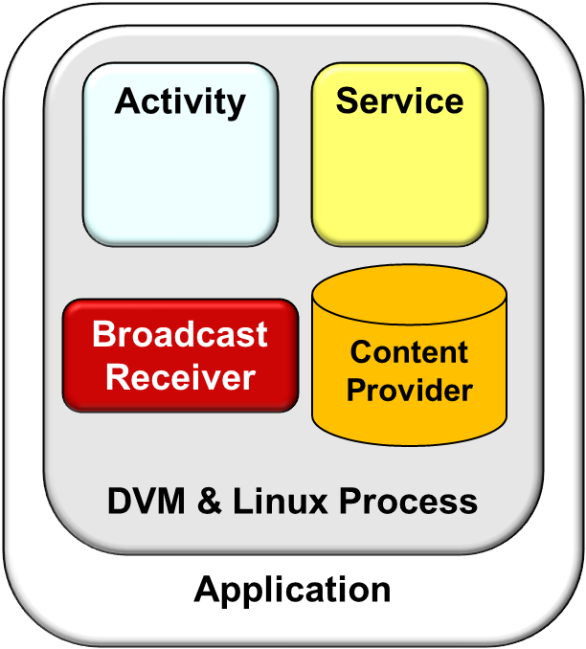
Summary
Android defines a layered software stack for mobile device
Apps are developed using framework components that Android can instantiate & run as needed
Application
DVM & Linux Process
Activity
Service
Content Provider
Broadcast Receiver
See developer.android.com/guide/components/fundamentals.html for more info

Slide 34

Summary
Android defines a layered software stack for mobile device
Apps are developed using framework components that Android can instantiate & run as needed
Most parts of Android are available in open-source format
See source.android.com for instructions on how to obtain Android source code
Notes:
http://www.flickr.com/photos/lwallenstein/3869245383/in/photostream/

Slide 35
Android Support for Programming Concurrent & Networked Software: Part 2
Douglas C. Schmidt
d.schmidt@vanderbilt.edu
www.dre.vanderbilt.edu/~schmidt
Professor of Computer Science
Institute for Software Integrated Systems Vanderbilt University Nashville, Tennessee, USA

Slide 36
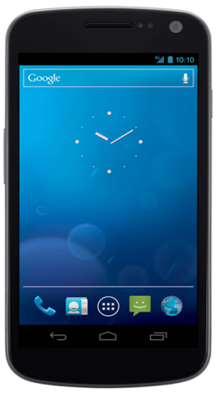



Topics Covered in this Part of the Module
Present an overview of the Android software architecture
Present an overview of Android mechanisms available to implement “networked” apps that
Communicate via the Sockets API &
Use other Android-specific IPC mechanisms
Socket
Socket
Process A
Process B
DownloadActivity
DownloadService
1: Call method downloadImage()
LocalBinder
mBoundService
downloadImage()
2: Return results to caller
Binder IPC Mechanism
There are no source code examples in this module (we’ll examine source later)

Slide 37
Overview of Android Communication Mechanisms
Android provides mechanisms for local IPC between processes on a device
e.g., AIDL/Binder
Process A
Process B
DownloadActivity
5: Call method downloadImage()
DownloadService
mBoundService
mBinder
bindService()
1: Bind to service
onBind()
4: Assign Proxy to local variable
2: Return ref to Binder object
ServiceConnection
LocalBinder
3: Downcast to Proxy
onServiceConnected()
downloadImage()
6: Stub dispatches method & returns result
Binder IPC Mechanism
www.nds.rub.de/media/attachments/files/2012/03/binder.pdf has more info

Slide 38


Overview of Android Communication Mechanisms
Android provides mechanisms for local IPC between processes on a device
e.g., AIDL/Binder
Many Android apps also use data & services via the Internet
e.g., Browser, Email, Calendar, Contacts, etc.
These apps typically use Sockets & TCP and/or HTTP to communicate
Socket
Socket
See http://developer.android.com/training/basics/network-ops/connecting.html

Slide 39
Overview of Android Binder & AIDL IPC
The Binder provides a local RPC mechanism for cross-process calls
Process A
Process B
Binder IPC Mechanism
DownloadActivity
DownloadService
1: Call method downloadImage()
LocalBinder
mBoundService
downloadImage()
2: Return results to caller

Slide 40
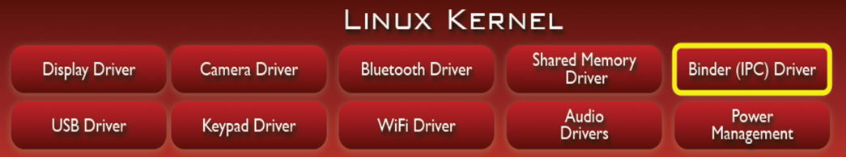
Overview of Android Binder & AIDL IPC
The Binder provides a local RPC mechanism for cross-process calls
The Binder Driver is installed in the Linux kernel to accelerate IPC
Uses shared memory & per-process thread pool for high performance
Process A
Process B
Binder IPC Mechanism
DownloadActivity
DownloadService
1: Call method downloadImage()
LocalBinder
mBoundService
downloadImage()
2: Return results to caller

Slide 41
Overview of Android Binder & AIDL IPC
The Binder provides a local RPC mechanism for cross-process calls
The Binder Driver is installed in the Linux kernel to accelerate IPC
Uses shared memory & per-process thread pool for high performance
Android system services can be written in C/C++, as well as Java
Process A
Process B
Binder IPC Mechanism
DownloadActivity
Native Download Service
1: Call method downloadImage()
C/C++ code
mBoundService
downloadImage()
2: Return results to caller
sites.google.com/site/io/anatomy--physiology-of-an-android has Binder overview

Slide 42
Overview of Android Binder & AIDL IPC
The Binder provides a local RPC mechanism for cross-process calls
The Binder Driver is installed in the Linux kernel to accelerate IPC
Uses shared memory & per-process thread pool for high performance
Android system services can be written in C/C++, as well as Java
Binder services described via Android Interface Definition Language (AIDL)
AIDL is similar to Java interfaces
interface IDownloadImage {
String downloadImage (String url);
}
Process A
Process B
Binder IPC Mechanism
DownloadActivity
DownloadService
1: Call method downloadImage()
LocalBinder
mBoundService
downloadImage()
2: Return results to caller

Slide 43
Overview of Android Binder & AIDL IPC
The Binder provides a local RPC mechanism for cross-process calls
The Binder Driver is installed in the Linux kernel to accelerate IPC
Uses shared memory & per-process thread pool for high performance
Android system services can be written in C/C++, as well as Java
Binder services described via Android Interface Definition Language (AIDL)
AIDL is similar to Java interfaces
Caller’s data is marshaled into parcels, copied to callee’s process, & demarshaled into what callee expects
Process A
Process B
Binder IPC Mechanism
DownloadActivity
DownloadService
1: Call method downloadImage()
LocalBinder
mBoundService
downloadImage()
2: Return results to caller

Slide 44
Overview of Android Binder & AIDL IPC
The Binder provides a local RPC mechanism for cross-process calls
The Binder Driver is installed in the Linux kernel to accelerate IPC
Uses shared memory & per-process thread pool for high performance
Android system services can be written in C/C++, as well as Java
Binder services described via Android Interface Definition Language (AIDL)
AIDL is similar to Java interfaces
Caller’s data is marshaled into parcels, copied to callee’s process, & demarshaled into what callee expects
AIDL supports synchronous calls between processes
Asynchrony supported via callbacks
Process A
Process B
Binder IPC Mechanism
DownloadActivity
DownloadService
1: Call method downloadImage()
LocalBinder
mBoundService
downloadImage()
2: Return results to caller
Caller thread blocks until results are returned

Slide 45
Overview of Android Binder & AIDL IPC
The Binder provides a local RPC mechanism for cross-process calls
The Binder Driver is installed in the Linux kernel to accelerate IPC
Uses shared memory & per-process thread pool for high performance
Android system services can be written in C/C++, as well as Java
Binder services described via Android Interface Definition Language (AIDL)
AIDL is similar to Java interfaces
Caller’s data is marshaled into parcels, copied to callee’s process, & demarshaled into what callee expects
AIDL supports synchronous calls between processes
Asynchrony supported via callbacks
Process A
Process B
Binder IPC Mechanism
DownloadActivity
DownloadService
1: Call method downloadImage()
LocalBinder
mBoundService
downloadImage()
2: Return results to caller
developer.android.com/guide/components/aidl.html has AIDL overview

Slide 46


Overview of Android Network Programming
Android includes multiple network programming classes, e.g.,
java.net – (Socket, URL, etc.)
org.apache – (HttpRequest, HttpResponse, etc.)
android.net – (AndroidHttpClient, URI, AudioStream, etc.)

Slide 47

Overview of Android Network Programming
Android includes multiple network programming classes, e.g.,
java.net – (Socket, URL, etc.)
org.apache – (HttpRequest, HttpResponse, etc.)
android.net – (AndroidHttpClient, URI, AudioStream, etc.)
Under the hood, Android’s HTTP libraries use the Java Sockets API
Socket
Socket
TCP/IP

Slide 48
Overview of Android Network Programming
Android includes multiple network programming classes, e.g.,
java.net – (Socket, URL, etc.)
org.apache – (HttpRequest, HttpResponse, etc.)
android.net – (AndroidHttpClient, URI, AudioStream, etc.)
Under the hood, Android’s HTTP libraries use the Java Sockets API
Even deeper under the hood Android’s java.net implementation uses the Linux C Socket API via JNI
Socket
Socket
TCP/IP

Slide 49
Overview of Android Network Programming
Android includes multiple network programming classes, e.g.,
java.net – (Socket, URL, etc.)
org.apache – (HttpRequest, HttpResponse, etc.)
android.net – (AndroidHttpClient, URI, AudioStream, etc.)
Under the hood, Android’s HTTP libraries use the Java Sockets API
Even deeper under the hood Android’s java.net implementation uses the Linux C Socket API via JNI
Socket
Socket
TCP/IP
Sockets are a common programming interface for network communication

Slide 50

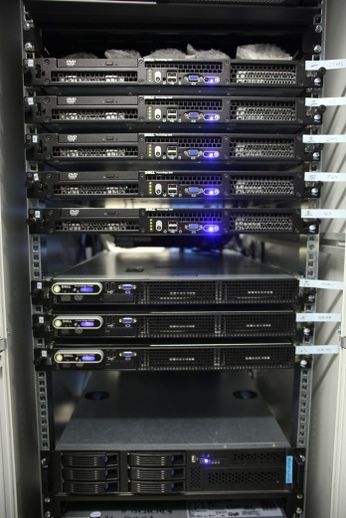
Overview of Java Sockets
Provides a client-side (& server-side) TCP socket
1: Passive Role
Provides a client-side
ServerSocket
accept() bind()
close()
Represents a server-side factory that waits for incoming client connections & creates connected Sockets
2: Active Role
Socket
bind()
close()
connect()
getInputStream()
getOutputStream()
Socket
3: Communication Role
Network
InputStream & OutputStream are used for app service processing

Slide 51



Summary
Android provides a wide range of local & remote IPC mechanisms
www.vogella.com/tutorials.html
There are many Android tutorials & resources available online

Slide 52
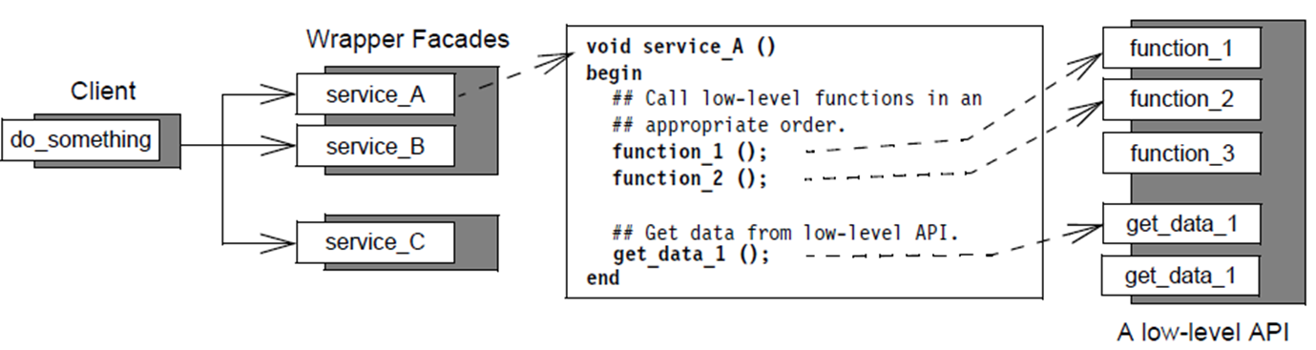
Summary
Android provides a wide range of local & remote IPC mechanisms
There are many patterns underlying these Android IPC mechanisms
Wrapper Facade
See www.dre.vanderbilt.edu/~schmidt/PDF/wrapper-facade.pdf

Slide 53
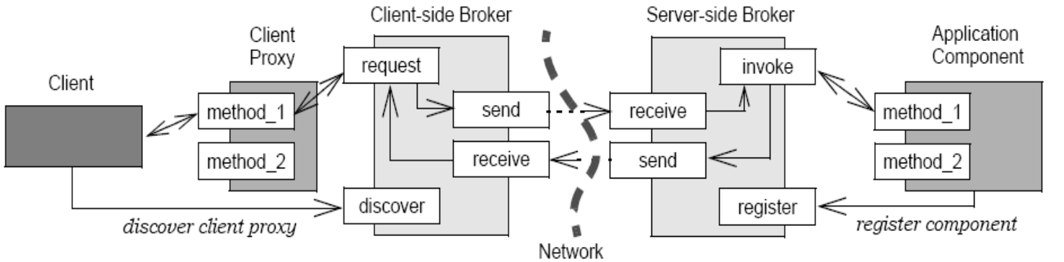
Summary
Android provides a wide range of local & remote IPC mechanisms
There are many patterns underlying these Android IPC mechanisms
Wrapper Facade
Broker
See www.kircher-schwanninger.de/michael/publications/BrokerRevisited.pdf

Slide 54
Android Support for Programming Concurrent & Networked Software: Part 3
Douglas C. Schmidt
d.schmidt@vanderbilt.edu
www.dre.vanderbilt.edu/~schmidt
Professor of Computer Science
Institute for Software Integrated Systems Vanderbilt University Nashville, Tennessee, USA

Slide 55
Topics Covered in this Part of the Module
Present an overview of the Android software architecture
Present an overview of Android mechanisms available to implement “networked” apps that
Communicate via the Sockets API &
Use other Android-specific IPC mechanisms
Present an overview of Android mechanisms available to implement concurrent apps that
Process requests simultaneously via multithreading
Synchronize their interactions
Message Queue
Background Thread A
Handler
Message
Message
Message
Looper
Handler
Message
Message
Background Thread B
Message
Message
Message
Async Task
UI Thread (main thread)
Again, we have no source code examples here since we’ll cover them later

Slide 56



Overview of Java Threads in Android
Android implements Java threads & concurrency classes
Conceptual view
Concurrent computations running in a process
Process A
Process B
Process C
Notes:
http://www.flickr.com/photos/36291048@N06/3389124067/

Slide 57

Overview of Java Threads in Android
Android implements Java threads & concurrency classes
Conceptual view
Concurrent computations running in a process
Implementation view
Each Java thread has a program counter & a stack (unique)
The heap & static areas are shared across threads (common)
Process A
Process B
Process C
See developer.android.com/guide/components/processes-and-threads.html
Notes:
http://www.flickr.com/photos/36291048@N06/3389124067, http://www.flickr.com/photos/61132483@N00/120759362/

Slide 58
Using Java Threads in Android
Thread
All threads must be given some code to run
You specify the code that should be run by extending Thread or implementing the Runnable interface
MyThread

Slide 59
Using Java Threads in Android
All threads must be given some code to run
You specify the code that should be run by extending Thread or implementing the Runnable interface
Threads/Runnables have a run() method that is called by the new thread after it starts up
: My Component
: MyThread
onCreate()
new()
start()
run()
Run concurrently

Slide 60
Using Java Threads in Android
All threads must be given some code to run
You specify the code that should be run by extending Thread or implementing the Runnable interface
Threads/Runnables have a run() method that is called by the new thread after it starts up
The thread stays active until run() returns
: My Component
: MyThread
onCreate()
new()
start()
run()
join()

Slide 61
Using Java Threads in Android
All threads must be given some code to run
You specify the code that should be run by extending Thread or implementing the Runnable interface
Threads/Runnables have a run() method that is called by the new thread after it starts up
The thread stays active until run() returns
: My Component
onCreate()

Slide 62
State Machine for Java Threads in Android
Blocking
new MyThread()
monitor obtained
attempt to access guarded resource
Created
Waiting
myThread.start()
lock.notify(), lock.notifyAll()
Runnable
Scheduler
lock.wait()
Running
sleeptime elapsed
run() method returns
Sleeping
Terminated
myThread.sleep()

Slide 63
State Machine for Java Threads in Android
Blocking
new MyThread()
monitor obtained
attempt to access guarded resource
Created
Waiting
myThread.start()
lock.notify(), lock.notifyAll()
Runnable
Scheduler
lock.wait()
Running
sleeptime elapsed
run() method returns
Sleeping
Terminated
myThread.sleep()

Slide 64
State Machine for Java Threads in Android
Blocking
new MyThread()
monitor obtained
attempt to access guarded resource
Created
Waiting
myThread.start()
lock.notify(), lock.notifyAll()
Runnable
Scheduler
lock.wait()
Running
sleeptime elapsed
run() method returns
Sleeping
Terminated
myThread.sleep()

Slide 65
State Machine for Java Threads in Android
Blocking
new MyThread()
monitor obtained
attempt to access guarded resource
Created
Waiting
myThread.start()
lock.notify(), lock.notifyAll()
Runnable
Scheduler
lock.wait()
Running
sleeptime elapsed
run() method returns
Sleeping
Terminated
myThread.sleep()

Slide 66
State Machine for Java Threads in Android
Blocking
new MyThread()
monitor obtained
attempt to access guarded resource
Created
Waiting
myThread.start()
lock.notify(), lock.notifyAll()
Runnable
Scheduler
lock.wait()
Running
sleeptime elapsed
run() method returns
Sleeping
Terminated
myThread.sleep()

Slide 67
State Machine for Java Threads in Android
Blocking
new MyThread()
monitor obtained
attempt to access guarded resource
Created
Waiting
myThread.start()
lock.notify(), lock.notifyAll()
Runnable
Scheduler
lock.wait()
Running
sleeptime elapsed
run() method returns
Sleeping
Terminated
myThread.sleep()

Slide 68
State Machine for Java Threads in Android
Blocking
new MyThread()
monitor obtained
attempt to access guarded resource
Created
Waiting
myThread.start()
lock.notify(), lock.notifyAll()
Runnable
Scheduler
lock.wait()
Running
sleeptime elapsed
run() method returns
Sleeping
Terminated
myThread.sleep()

Slide 69
State Machine for Java Threads in Android
Blocking
new MyThread()
monitor obtained
attempt to access guarded resource
Created
Waiting
myThread.start()
lock.notify(), lock.notifyAll()
Runnable
Scheduler
lock.wait()
Running
sleeptime elapsed
run() method returns
Sleeping
Terminated
myThread.sleep()

Slide 70
Synchronizing Java Threads in Android
Java provides the “synchronized” keyword to specify sections of code in an object that cannot be accessed concurrently by two threads
Only a single synchronized method can be active in any given object
public synchronized void onLocationChanged(Location location) {
if (null == mBestReading || mBestReading.getTime() - System.currentTimeMillis() > TWO_MIN || location.getAccuracy() < mBestReading.getAccuracy()) {
mBestReading = location;
mTextView.setText(getDisplayString(location));
}
}

Slide 71
Synchronizing Java Threads in Android
Java provides the “synchronized” keyword to specify sections of code in an object that cannot be accessed concurrently by two threads
Only a single synchronized method can be active in any given object
public synchronized void onLocationChanged(Location location) {
if (null == mBestReading || mBestReading.getTime() - System.currentTimeMillis() > TWO_MIN || location.getAccuracy() < mBestReading.getAccuracy()) {
mBestReading = location;
mTextView.setText(getDisplayString(location));
}
}

Slide 72
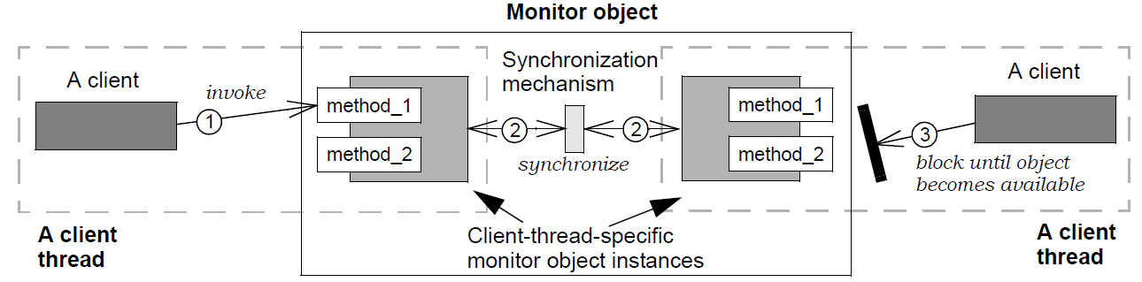
Synchronizing Java Threads in Android
Java provides the “synchronized” keyword to specify sections of code in an object that cannot be accessed concurrently by two threads
Only a single synchronized method can be active in any given object
Java objects with synchronized methods use the Monitor Object pattern
See www.dre.vanderbilt.edu/~schmidt/PDF/monitor.pdf for Monitor Object

Slide 73
Synchronizing Java Threads in Android
Java provides the “synchronized” keyword to specify sections of code in an object that cannot be accessed concurrently by two threads
Only a single synchronized method can be active in any given object
Java objects with synchronized methods can use the Monitor Object pattern
A broader range of Java synchronizers are available in java.util.concurrent.*
e.g., Lock, Semaphore, Condition, ReadWriteLock, etc.
developer.android.com/reference/java/util/concurrent/package-summary.html

Slide 74
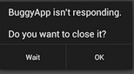
Motivating Android Concurrency Idioms
Android’s UI has several design constraints
An “Application Not Responding” (ANR) dialog is generated if app’s UI Thread doesn’t respond to user input within a short time
Also, non-UI thread can’t access UI toolkit since it’s not thread-safe
See developer.android.com/training/articles/perf-anr.html for more on ANRs

Slide 75
Motivating Android Concurrency Idioms
Android’s UI has several design constraints
An “Application Not Responding” (ANR) dialog is generated if app’s UI Thread doesn’t respond to user input within a short time
Also, non-UI thread can’t access UI toolkit since it’s not thread-safe
Android thus supports various concurrency idioms for processing long-running operations in background thread(s) & communicating with UI Thread
AsyncTask
Handlers, Messages, & Runnables
Message Queue
Background Thread A
Handler
Message
Message
Message
Looper
Handler
Message
Message
Background Thread B
Message
Message
Message
Async Task
UI Thread (main thread)

Slide 76
Android AsyncTask
AsyncTask provides a structured way to manage work involving background & UI threads
Simplifies creation of long-running tasks that need to communicate with the UI
: UI Thread
: My AsyncTask
: Default Executor
: Worker Runnable
execute
execute
doInBackground
onPreExecute
onPostExecute

Slide 77
Android AsyncTask
AsyncTask provides a structured way to manage work involving background & UI threads
Simplifies creation of long-running tasks that need to communicate with the UI
Must be subclassed & hook methods overridden
: UI Thread
: My AsyncTask
: Default Executor
: Worker Runnable
Template method
Perform long-running task
execute
execute
doInBackground
onPreExecute
onPostExecute
Display results in UI
Initialization actions
developer.android.com/reference/android/os/AsyncTask.html has AsyncTask info

Slide 78
Handlers, Messages, & Runnables
Threads in Android also communicate by exchanging Messages & Runnables
UI Thread
UI Thread performs user interaction, system callbacks, & Activity lifecycle methods
Connects to looper to manage & dispatch MessageQueue entries
Message Queue
Message
Looper
Message
Message
Message
Message
3. handleMessage()
Message
UI Thread (main thread)
See developer.android.com/training/multiple-threads/communicate-ui.html

Slide 79
Handlers, Messages, & Runnables
Threads in Android also communicate by exchanging Messages & Runnables
UI Thread
UI Thread performs user interaction, system callbacks, & Activity lifecycle methods
Connects to looper to manage & dispatch MessageQueue entries
Handler
Sends Messages & Runnables to UI Thread from other threads
Schedules Messages & Runnables for future execution
Enqueues actions to perform on a different thread
Message Queue
Background Thread A
Handler
1. handler. sendMessage (msg)
Message
Message
Looper
Message
Message
Message
Handler
2. handler.post(new Runnable() {public void run() { /* … */ }});
Message
Message
Background Thread B
3. handleMessage()
Message
UI Thread (main thread)
www.vogella.com/articles/AndroidBackgroundProcessing/article.html has more

Slide 80
Summary
Android provides a range of concurrency mechanisms that apps can use to manage multiple threads that run concurrently within a process
Process A
Process B
Process C

Slide 81
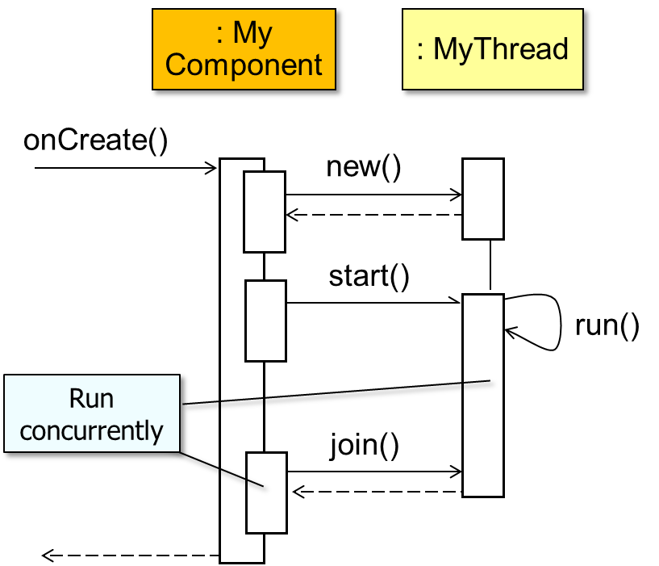
Summary
Android provides a range of concurrency mechanisms that apps can use to manage multiple threads that run concurrently within a process
Some mechanisms are based on standard Java threading & synchronization mechanisms

Slide 82
Summary
Android provides a range of concurrency mechanisms that apps can use to manage multiple threads that run concurrently within a process
Some mechanisms are based on standard Java threading & synchronization mechanisms
Other mechanisms are based on Android concurrency idioms
Background Thread A
Message Queue
Handler
Message
Message
Message
Looper
Handler
Message
Message
Background Thread B
Message
Message
Message
Async Task
UI Thread (main thread)

Slide 83
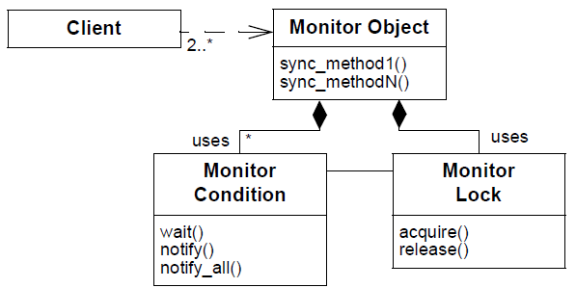
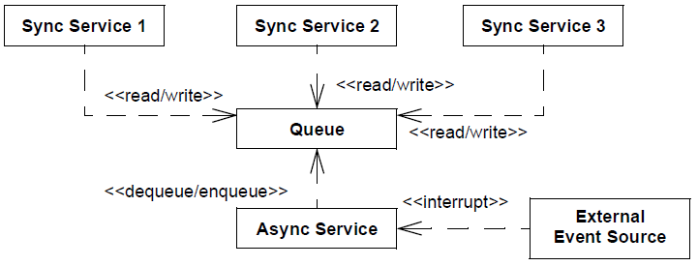
Summary
Android provides a range of concurrency mechanisms that apps can use to manage multiple threads that run concurrently within a process
Some mechanisms are based on standard Java threading & synchronization mechanisms
Other mechanisms are based on Android concurrency idioms
There are many patterns underlying these Android concurrency mechanisms
Monitor
Object
Half-Sync/ Half-Async
See monitor.pdf & HS-HA.pdf at www.dre.vanderbilt.edu/~schmidt/PDF

Slide 84
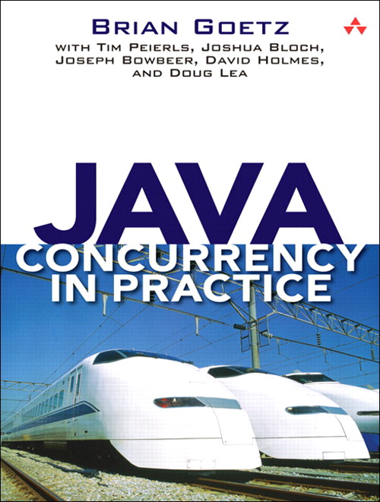
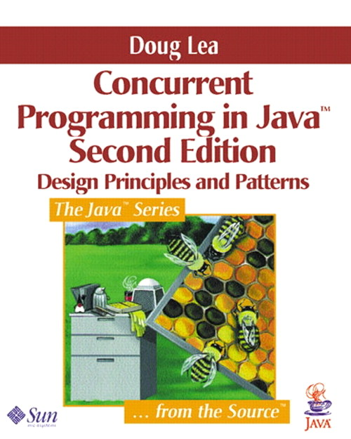
Summary
Android provides a range of concurrency mechanisms that apps can use to manage multiple threads that run concurrently within a process
Some mechanisms are based on standard Java threading & synchronization mechanisms
Other mechanisms are based on Android concurrency idioms
There are many patterns underlying these Android concurrency mechanisms
There are good books on Java concurrency & patterns
See online supplement at gee.cs.oswego.edu/dl/cpj

